Slide 1
Helping your Child at Home with Writing!
Kindergarten and First Grade
Created by Megan Corrao

Slide 2
Kindergarten Genres
Writing about Reading
Non-fiction-ABC book
Book Reviews
Thank you Letter
Personal Narrative
Picture/Fact Book
Poetry

Slide 3
First Grade Genres
Writing about Reading
Personal Narrative (Narrative)
Friendly Letters
Book Review (Opinion)
Realistic Fiction
All About (Informative)
How to Book
Poetry

Slide 4
Kindergarten Personal Narrative
Notes:
Child was able to demonstrate her understanding of how to write a personal narrative and stayed with the main idea. Beginnning and ending sound and using I and ending with a period.

Slide 5
First Grade Personal Narrative

Slide 6
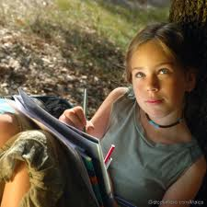
Reading and Writing are connected!
Writing helps kids become
better readers!
Notes:
And learning to write well helps children to be better readers. They are observing the way writing is used in our everyday lives.

Slide 7
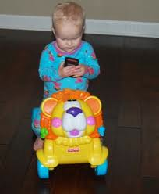
Children mirror what they see around them; parents and older siblings writing notes, lists, text messaging, and answering emails
Notes:
When engaging in writing, young children often mirror what they see around them – adults and older children writing lists, notes, text messaging.

Slide 8
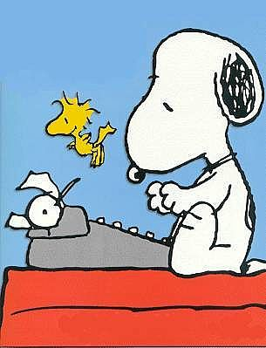
Focus on meaning first. Write with the reader in mind.

Slide 9
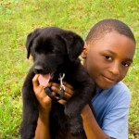
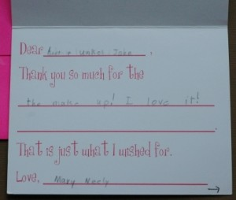
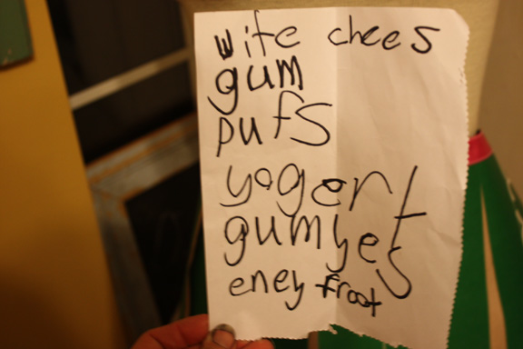
Purposeful writing activities to do with your child!
Notes:
Have your child write instructions for taking care of the family pet.
Write a letter or thank you note to a relative. Talk through what your child wants to say before writing begins.
Make a shopping list before going to the grocery store.
Start keeping a personal diary, a household guestbook, or a baby book for a younger sibling.

Slide 10
Activities to do at Home:
The photographic activity
Authentic writing experiences (letters, emails, thank you notes, grocery store lists)
Menus
Diaries/Journals
Create books

Slide 11
Activities continued..
Genre Writing
Travel Logs/Memoir
Nature Journals
Word Games to teach Writing Skills

Slide 12
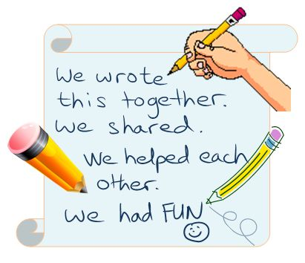
Most importantly… have fun with writing!
Notes:
Talk about spelling and conventions here.

