Slide 1

Spring into Writing
Presented by the Language Arts Committee

Slide 2
Purpose of the evening
To provide an overview of writing expectations as indicated by the Maryland College and Career-Ready Standards
To provide ideas for motivating children to write
To provide fun ideas for writing opportunities at home

Slide 3

Format of the Evening
6:00-6:30 – Overview of Writing Expectations in cafeteria
6:35-6:55 - First Rotation
K-1 – Classroom A in First Grade
2-3 – Classroom B in First Grade
4-5 – Classroom C in First Grade
7: 00-7:20 – Second Rotation
K-1 – Classroom A in First Grade
2-3 – Classroom B in First Grade
4-5 – Classroom C in First Grade

Slide 4
Maryland State Standards
Text Types and Purposes
  1. Write opinion pieces with reasons to support that opinion.
  2. Write informative/explanatory texts to examine a topic and convey ideas and information clearly.
  3. Write narratives to develop real or imagined experiences or events.

Slide 5
Standards cont.
Production and Distribution of Writing
4. Produce writing in which the development and organization are appropriate to task and purpose (begins in grade 3).
5. Develop and strengthen writing as needed by planning, revising, and editing.
6. Use technology to produce and publish writing (using keyboarding skills) as well as to interact and collaborate with others.

Slide 6
Standards cont.
Research to Build and Present Knowledge
7. Conduct research projects that build knowledge about a topic.
8. Recall information from experiences or gather information from print and digital sources.
9. Draw evidence from literary or informational texts to support analysis, reflection, and research (begins in grade 4).

Slide 7
Standards cont.
Range of Writing
10. Grades 3-12 - Write routinely over extended time frames (time for research, reflection, and revision) and shorter time frames (a single sitting or a day or two) for a range of discipline-specific tasks, purposes, and audiences.
Note: This is a general list of the Anchor Standards. Grade specific standards can be found at
http://www.corestandards.org/ELA-Literacy/

Slide 8
How Writing Develops
Scribbling/drawing
Letter-like forms and shapes
Letters and spaces
Conventional writing and spelling
http://www.readingrockets.org/article/how-writing-develops

Slide 9
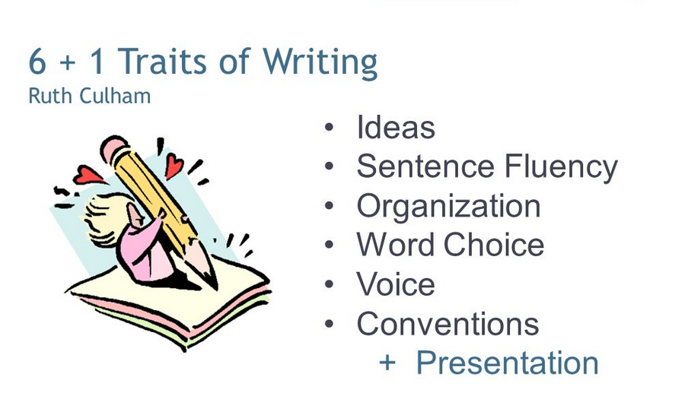

Slide 10
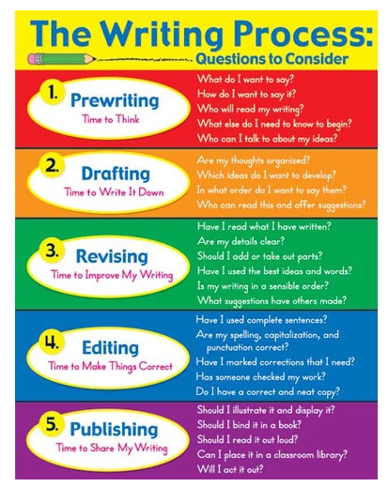

Slide 11
Motivation
the reason or reasons one has for acting or behaving in a particular way
the general desire or willingness of someone to do something
- New Oxford American Dictionary

Slide 12
Goal setting
Set goals based on your child’s writing and include your child during this process.
Set small, manageable, short term goals (see examples of goals in your handout)
Reward your child as often as needed. Younger students need more frequent, immediate and tangible rewards, while older children can be rewarded less frequently, be given more abstract rewards, and can usually wait a reasonable amount of time before actually receiving the reward.

Slide 13
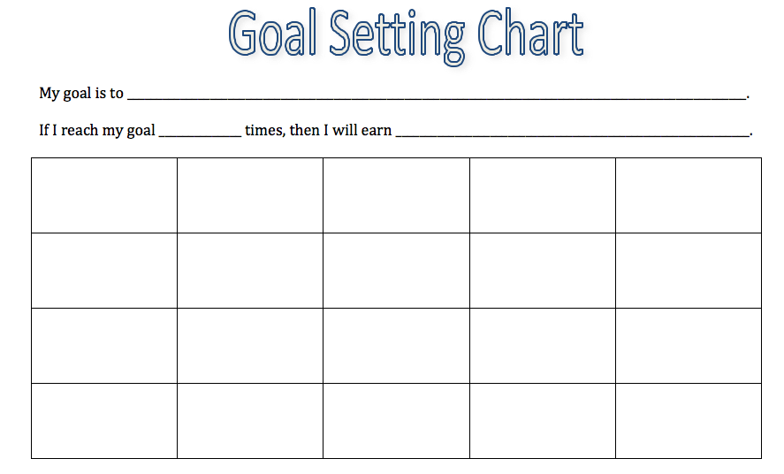

Slide 14
Possible Reward Systems
Marble jar
Sticker chart
Tally mark chart
Pieces to a puzzle
Game boards
Writing Bucks/Monopoly Money

Slide 15
Possible Incentives
Coupon reward
Special individual time with parent or family member
Ice cream/yogurt outing
Special day trip
Trip to the book store
Movie night
Whatever the incentive, be sure to include your child in choosing his/her reward.

Slide 16
  Why do we want to encourage our children to write?
To build writing stamina
To get children to feel comfortable with writing
To ensure future success
To get children to LOVE writing and sharing their ideas

Slide 17
The Reading and Writing Connection
Remember:
Reading and writing are interconnected.
Strong writers are avid readers.
Be sure to encourage reading across a variety of text types and genres.
Encourage your students to draw before they write.

Slide 18
Resources
Reading Genre Bingo Board
HC Library Summer Reading Club
HC Library booklist
www.abookandahug.com

Slide 19
Keep writing fun!
In the smaller breakout sessions, you will get a look at writing samples from each grade level and receive engaging activities to do with your child at home.
If you keep writing fun, children will want to keep doing it.
Giving children writing choices helps them be in control of their success and motivates them to continue growing as writers.

